Slide 1
EXPLORATORY DATA ANALYSIS (EDA)

Slide 2
Introduction
Exploratory Data Analysis (EDA) is a crucial initial step in data science projects.
EDA involves analysing and visualizing data to understand its key characteristics, uncover patterns, locate outliers and identify relationships between variables.
EDA is normally carried out as a preliminary step before undertaking extra formal statistical analyses or Modeling.

Slide 3
Key aspects of EDA
Distribution of Data: Examining the distribution of data points to understand their range, central tendencies (mean, median), and dispersion (variance, standard deviation).
Graphical Representations: Utilizing charts such as histograms, box plots, scatter plots, and bar charts to visualize relationships within the data and distributions of variables.
Outlier Detection: Identifying unusual values that deviate from other data points. Outliers can influence statistical analyses and might indicate data entry errors or unique cases.

Slide 4
Continued…
Correlation Analysis: Checking the relationships between variables to understand how they might affect each other. This includes computing correlation coefficients and creating correlation matrices.
Handling Missing Values: Detecting and deciding how to address missing data points, whether by imputation or removal, depending on their impact and the amount of missing data.
Summary Statistics: Calculating key statistics that provide insight into data trends and nuances.
Testing Assumptions: Many statistical tests and models assume the data meet certain conditions. EDA helps verify these assumptions.

Slide 5
Importance of EDA
Understanding Data Structures: EDA helps in getting familiar with the dataset, understanding the number of features, the type of data in each feature, and the distribution of data points. This understanding is crucial for selecting appropriate analysis or prediction techniques.
Identifying Patterns and Relationships: Through visualizations and statistical summaries, EDA can reveal hidden patterns and intrinsic relationships between variables. These insights can guide further analysis and enable more effective feature engineering and model building.

Slide 6
Continued…
Detecting Anomalies and Outliers: EDA is essential for identifying errors or unusual data points that may adversely affect the results of your analysis. Detecting these early can prevent costly mistakes in predictive modeling and analysis.
Testing Assumptions: Many statistical models assume that data follow a certain distribution or that variables are independent. EDA involves checking these assumptions. If the assumptions do not hold, the conclusions drawn from the model could be invalid.
Informing Feature Selection and Engineering: Insights gained from EDA can inform which features are most relevant to include in a model and how to transform them (scaling, encoding) to improve model performance.

Slide 7
Continued…
Optimizing Model Design: By understanding the data’s characteristics, analysts can choose appropriate modeling techniques, decide on the complexity of the model, and better tune model parameters.
Facilitating Data Cleaning: EDA helps in spotting missing values and errors in the data, which are critical to address before further analysis to improve data quality and integrity.
Enhancing Communication: Visual and statistical summaries from EDA can make it easier to communicate findings and convince others of the validity of your conclusions, particularly when explaining data-driven insights to stakeholders without technical backgrounds.

Slide 8
Types of Exploratory Data Analysis
EDA refers to the method of analysing information units to uncover styles, pick out relationships, and gain insights.
There are various sorts of EDA strategies that can be hired relying on the nature of the records and the desires of the evaluation.
Depending on the number of columns we can divide EDA into three types: Univariate, bivariate and multivariate.

Slide 9
1. Univariate Analysis
Univariate analysis focuses on a single variable to understand its internal structure. It is primarily concerned with describing the data and finding patterns existing in a single feature. Common techniques include:
Histograms: Used to visualize the distribution of a variable.
Box plots: Useful for detecting outliers and understanding the spread and skewness of the data.
Bar charts: Employed for categorical data to show the frequency of each category.
Summary statistics: Calculations like mean, median, mode, variance, and standard deviation that describe the central tendency and dispersion of the data.

Slide 10
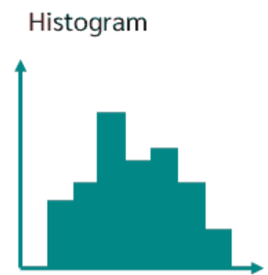
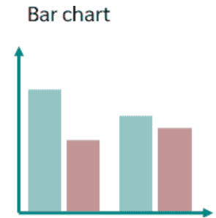
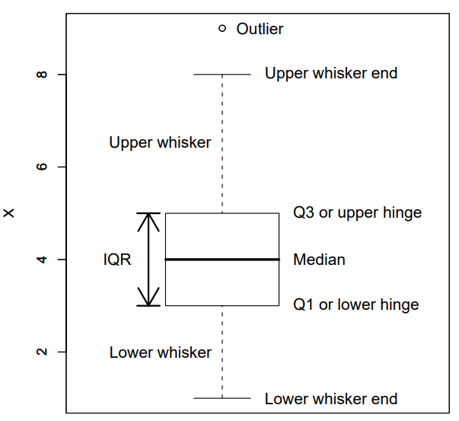
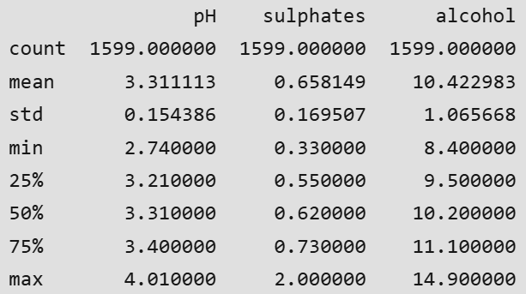
Example…

Slide 11
2. Bivariate Analysis
Bivariate evaluation involves exploring the connection between variables. It enables find associations, correlations, and dependencies between pairs of variables. Bivariate analysis examines the relationship between two variables. Some key techniques used in bivariate analysis:
Scatter Plots: These are one of the most common tools used in bivariate analysis. A scatter plot helps visualize the relationship between two continuous variables.
Correlation Coefficient: This statistical measure (often Pearson’s correlation coefficient for linear relationships) quantifies the degree to which two variables are related.
Cross-tabulation: Also known as contingency tables, cross-tabulation is used to analyse the relationship between two categorical variables. It shows the frequency distribution of categories of one variable in rows and the other in columns, which helps in understanding the relationship between the two variables.

Slide 12
Continued…
Line Graphs: In the context of time series data, line graphs can be used to compare two variables over time. This helps in identifying trends, cycles, or patterns that emerge in the interaction of the variables over the specified period.
Covariance: Covariance is a measure used to determine how much two random variables change together. However, it is sensitive to the scale of the variables, so it’s often supplemented by the correlation coefficient for a more standardized assessment of the relationship.

Slide 13
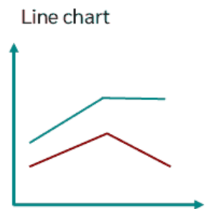
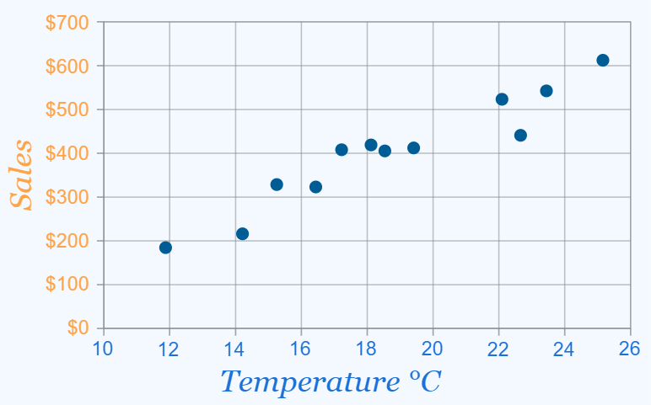
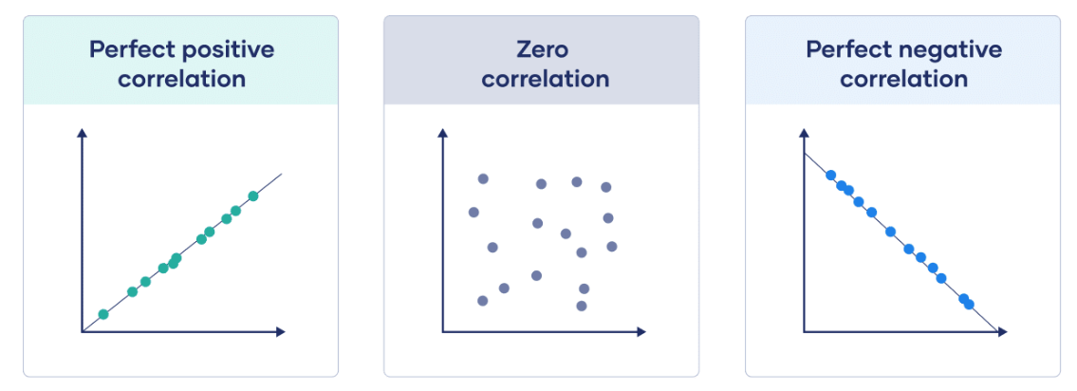
Example

Slide 14
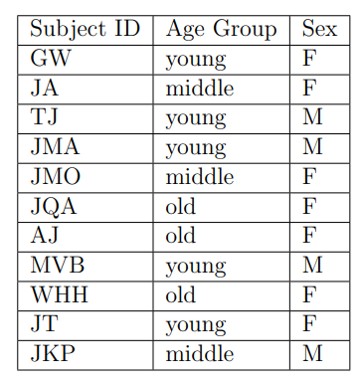
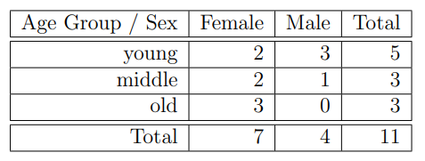
Cross Tabulation

Slide 15
3. Multivariate Analysis
Multivariate analysis examines the relationships between two or more variables in the dataset. It aims to understand how variables interact with one another, which is crucial for most statistical modeling techniques. Techniques include:
Pair plots: Visualize relationships across several variables simultaneously to capture a comprehensive view of potential interactions.
Principal Component Analysis (PCA): A dimensionality reduction technique used to reduce the dimensionality of large datasets, while preserving as much variance as possible.

Slide 16
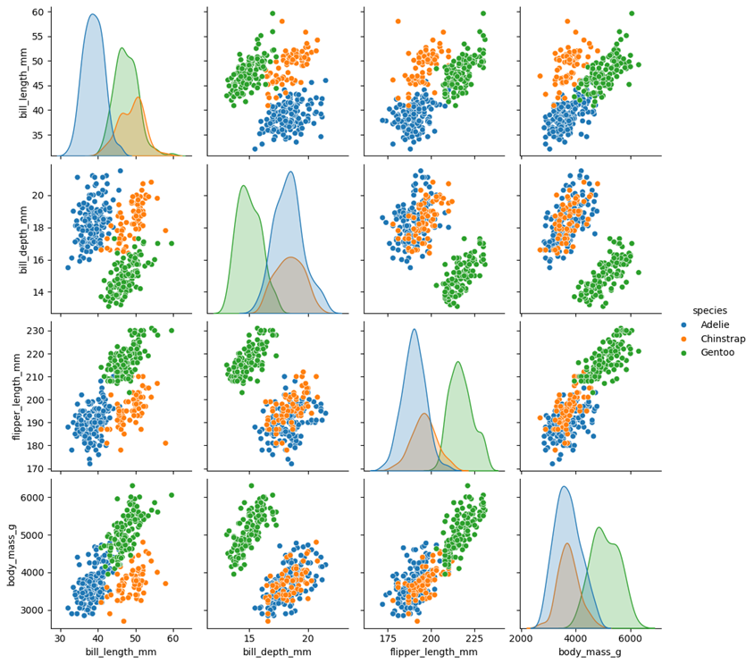

Slide 17
Tools for Performing Exploratory Data Analysis
Exploratory Data Analysis (EDA) can be effectively performed using a variety of tools and software, each offering unique features suitable for handling different types of data and analysis requirements.
1. Python Libraries
Pandas: Provides extensive functions for data manipulation and analysis, including data structure handling and time series functionality.
Matplotlib: A plotting library for creating static, interactive, and animated visualizations in Python.
Seaborn: Built on top of Matplotlib, it provides a high-level interface for drawing attractive and informative statistical graphics.
Plotly: An interactive graphing library for making interactive plots and offers more sophisticated visualization capabilities.

Slide 18
Continued…
2. R Packages
ggplot2: Part of the tidyverse, it’s a powerful tool for making complex plots from data in a data frame.
dplyr: A grammar of data manipulation, providing a consistent set of verbs that help you solve the most common data manipulation challenges.
tidyr: Helps to tidy your data. Tidying your data means storing it in a consistent form that matches the semantics of the dataset with the way it is stored.

Slide 19
Steps for Performing Exploratory Data Analysis
Performing Exploratory Data Analysis (EDA) involves a series of steps designed to help us understand the data we’re working with, uncover underlying patterns, identify anomalies, test hypotheses, and ensure the data is clean and suitable for further analysis.

Slide 20
Step 1: Understand the Problem and the Data
The first step in any information evaluation project is to sincerely apprehend the trouble you are trying to resolve and the statistics you have at your disposal. This entails asking questions consisting of:
What is the enterprise goal or research question you are trying to address?
What are the variables inside the information, and what do they mean?
What are the data sorts (numerical, categorical, textual content, etc.) ?
Is there any known information on first-class troubles or obstacles?
Are there any relevant area-unique issues or constraints?
By thoroughly knowing the problem and the information, you can better formulate your evaluation technique and avoid making incorrect assumptions or drawing misguided conclusions.

Slide 21
Step 2: Import and Inspect the Data
Once you have clean expertise of the problem and the information, the following step is to import the data into your evaluation environment (e.g., Python, R, or a spreadsheet program). During this step, looking into the statistics is critical to gain initial know-how of its structure, variable kinds, and capability issues.
Here are a few obligations you could carry out at this stage:
Load the data into your analysis environment, ensuring that the facts are imported efficiently and without errors.
Examine the size of the data (variety of rows and columns) to experience its length and complexity.
Check for missing values and their distribution across variables, as missing information can notably affect the quality and reliability of your evaluation.
Identify facts sorts and formats for each variable, as these records may be necessary for the following facts manipulation and evaluation steps.
Look for any apparent errors or inconsistencies in the information, such as invalid values, mismatched units, or outliers, that can indicate exceptional issues with information.

Slide 22
Step 3: Handle Missing Data
Missing records can significantly impact the quality and reliability of your evaluation. During the EDA method, missing data can result in biased or misleading outcomes. Here are some techniques you could use to handle missing statistics:
Understand the styles and capacity reasons for missing statistics: Is the information lacking entirely at random (MCAR), lacking at random (MAR), or lacking not at random (MNAR)? Understanding the underlying mechanisms can inform the proper method for handling missing information.
Decide whether to eliminate observations with lacking values (listwise deletion) or attribute (fill in) missing values: Removing observations with missing values can result in a loss of statistics and potentially biased outcomes. Imputing missing values can assist in preserving treasured facts. However, the imputation approach needs to be chosen cautiously.
Use suitable imputation strategies, such as mean/median imputation, regression imputation, a couple of imputations, k-nearest associates (KNN) or selection trees. The preference for the imputation technique has to be primarily based on the characteristics of the information and the assumptions underlying every method.
Consider the effect of lacking information: Even after imputation, missing values can introduce uncertainty and bias. It is important to acknowledge those limitations and interpret your outcomes with warning.

Slide 23
Step 4: Explore Data Characteristics
After addressing the data that are missing, the next step within the EDA technique is to explore the characteristics of your statistics. This entails examining your variables’ distribution, crucial tendency, and variability and identifying any ability outliers or anomalies.
Calculate summary facts (suggest, median, mode, preferred deviation, skewness, kurtosis, and many others.) for numerical variables: These facts provide a concise assessment of the distribution and critical tendency of each variable, aiding in the identification of ability issues or deviations from expected patterns.

Slide 24
Step 5: Perform Data Transformation
Data transformation is a critical step within the EDA process because it enables you to prepare your statistics for similar evaluation and modeling. Here are a few common records transformation strategies:
Scaling or normalizing numerical variables to a standard variety (e.g., min-max scaling, standardization)
Encoding categorical variables to be used in machine mastering fashions (e.g., one-hot encoding, label encoding)
Applying mathematical differences to numerical variables (e.g., logarithmic, square root) to correct for skewness or non-linearity.
Aggregating or grouping records mainly based on unique variables.
By accurately transforming your information, you could ensure that your evaluation and modeling strategies are implemented successfully and that your results are reliable and meaningful.

Slide 25
Step 6: Visualize Data Relationships
Visualization is an effective tool in the EDA, as it allows to discover relationships between variables and become aware of styles or trends that may not immediately be apparent from summary statistics or numerical outputs. To visualize data relationships, explore univariate, bivariate, and multivariate analysis.
Create frequency tables, bar plots, and pie charts for express variables: These visualizations can help you apprehend the distribution of classes and discover any ability imbalances or unusual patterns.
Generate histograms, container plots, violin plots, and density plots to visualize the distribution of numerical variables. These visualizations can screen critical information about the form, unfold, and ability outliers within the statistics.
Examine the correlation or association among variables using scatter plots, correlation matrices, or statistical assessments like Pearson’s correlation coefficient or Spearman’s rank correlation: Understanding the relationships between variables can tell characteristic choice, dimensionality discount, and modeling choices.

Slide 26
Step 7: Handling Outliers
An Outlier is a data item/object that deviates significantly from the rest of the (so-called normal) data. They can be caused by measurement or execution errors.
The analysis for outlier detection is referred to as outlier mining. There are many ways to detect outliers.
Identify and inspect capability outliers through the usage of strategies like the interquartile range (IQR), Z-scores.

Slide 27
Step 8: Communicate Findings and Insights
The final step in the EDA technique is effectively discussing your findings and insights. This includes summarizing your evaluation, highlighting fundamental discoveries, and imparting your outcomes cleanly. Here are a few hints for effective verbal exchange:
Clearly state the targets and scope of your analysis
Provide context and heritage data to assist others in apprehending your approach
Use visualizations and images to guide your findings and make them more reachable
Highlight critical insights, patterns, or anomalies discovered during EDA.
Discuss any barriers related to your analysis

